Slide 1
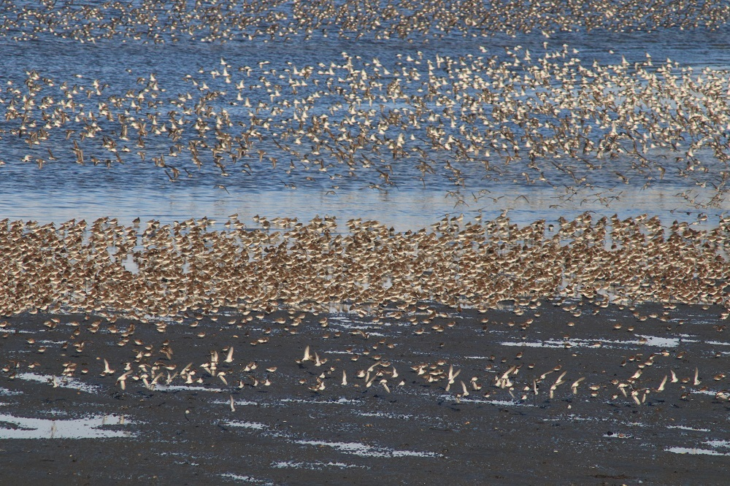

Monitoring Kachemak Bay’s Spring Shorebird Migration
George Matz
Kachemak Bay Birders

Slide 2
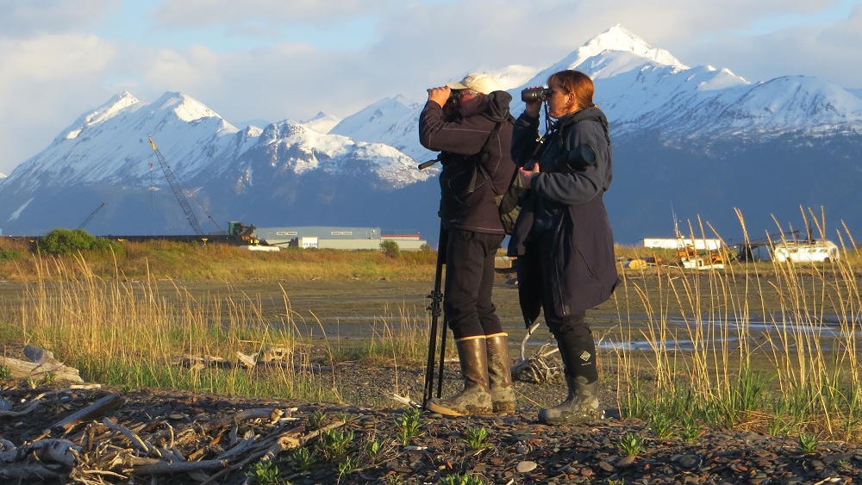
Below dramatic peaks and jagged cliffs, a complex area of spits, tidal flats, sandy beaches, and rocky shores supports an abundance and diversity of wildlife, including 36 species of shorebirds. These shorebirds have long been part of the Kachemak Bay story…In 1996 Kachemak Bay was designated a WHSRN site, formalizing its identification as one of the most important sites for migrating shorebirds in Alaska…Since then, Kachemak Bay Birders have submitted 13 years’ worth of data for one of the most important shorebird staging sites in Alaska… making it one of the most well-covered sites in the hemisphere for ISS. International Shorebird Survey Newsletter, Sept. 2021.

Slide 3
Kachemak Bay Birders Purpose for Monitoring
Long-term Objectives:
1) To attain a better understanding of the status of shorebird populations in Kachemak Bay as well as the intertidal areas of the Anchor and Kasilof Rivers, particularly during spring migration.
2) To provide local birders with more opportunity to observe and enjoy shorebirds.
Secondary Objectives:
To contribute information that might be useful to others assessing shorebird populations across the entire Pacific Flyway.
2) To use the monitoring data to help protect shorebird populations and habitat on the western side of the Kenai Peninsula.

Slide 4
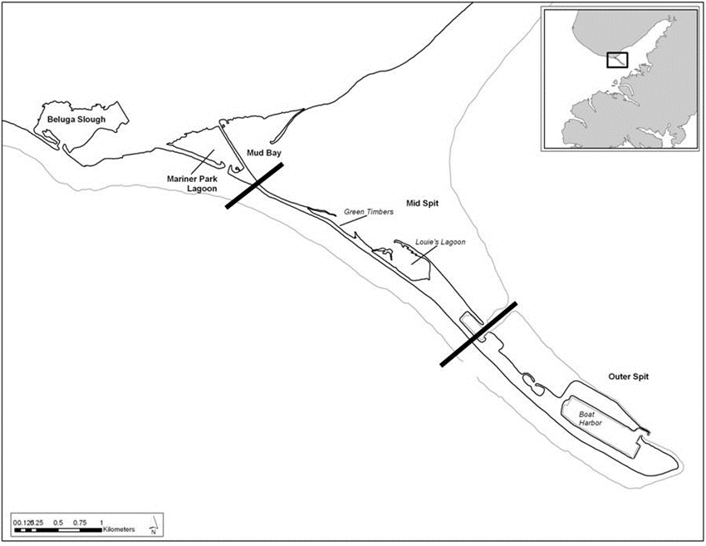
Monitoring Sites in the Homer Spit Area
Each Has a Different Type of Habitat

Slide 5
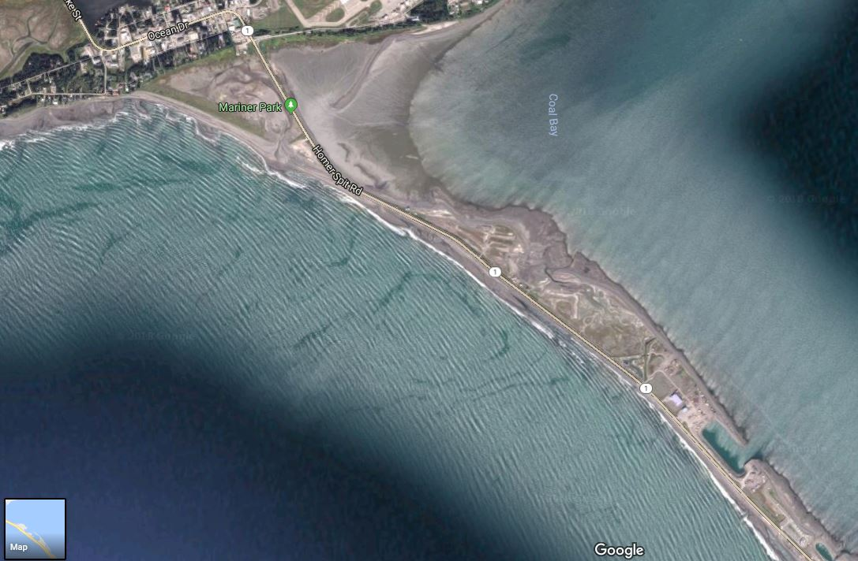
Mud Bay, Mariner Park Lagoon, and Mid-Spit Sites

Slide 6
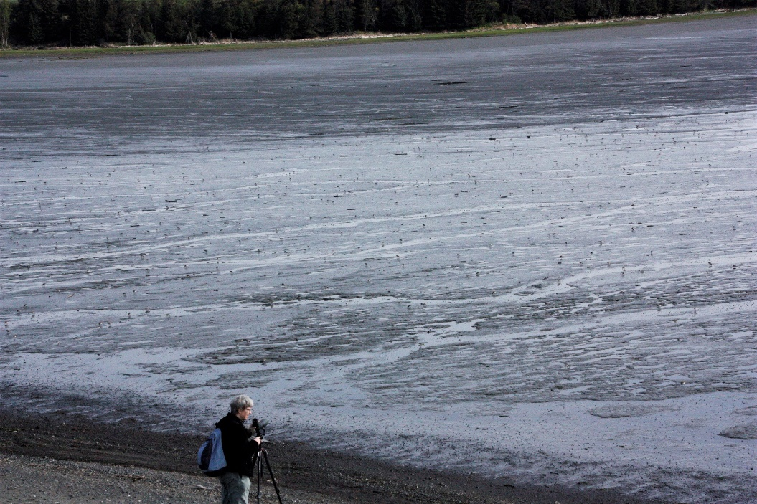
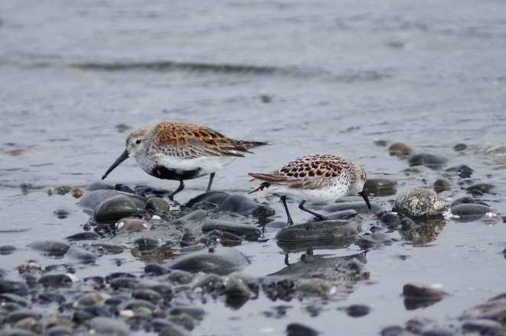
Mud Bay Site

Slide 7
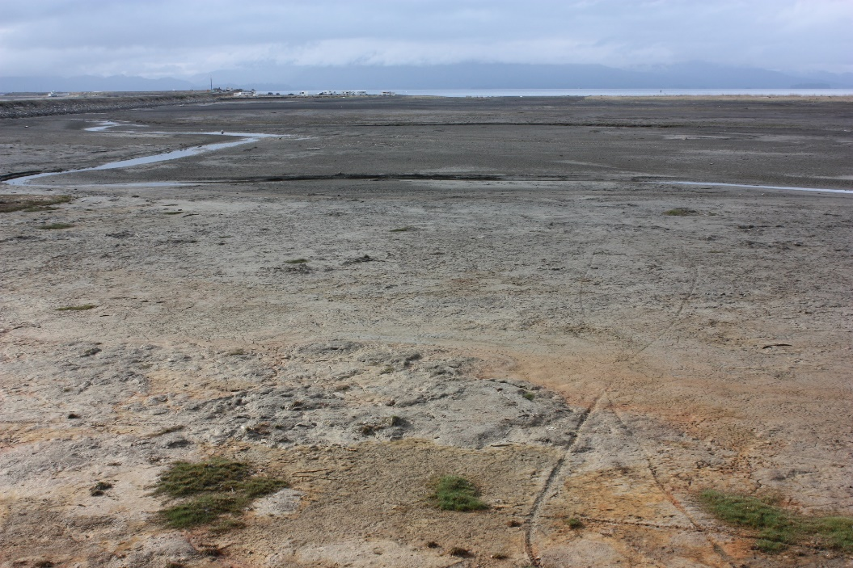
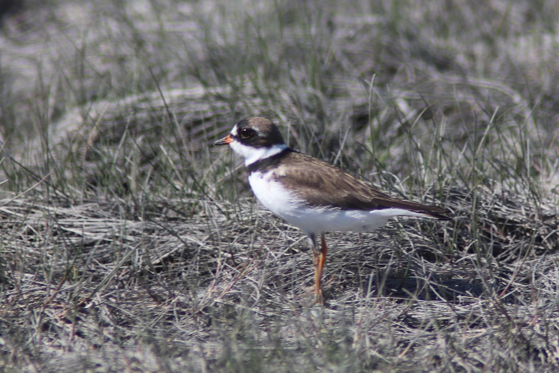
Mariner Park Lagoon Site

Slide 8
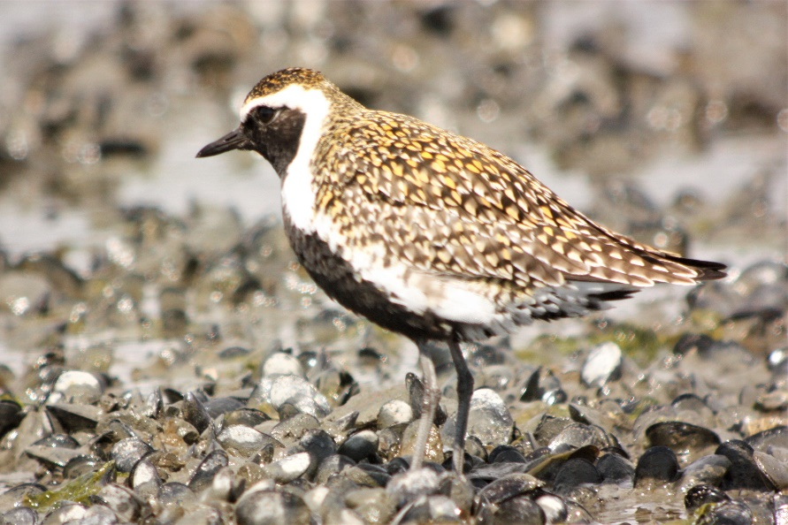
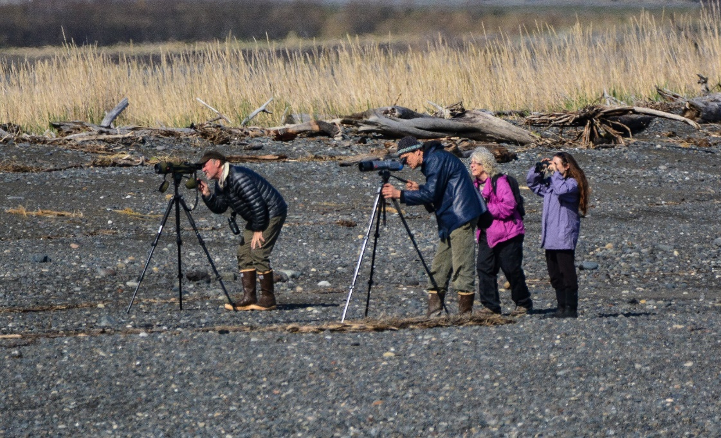
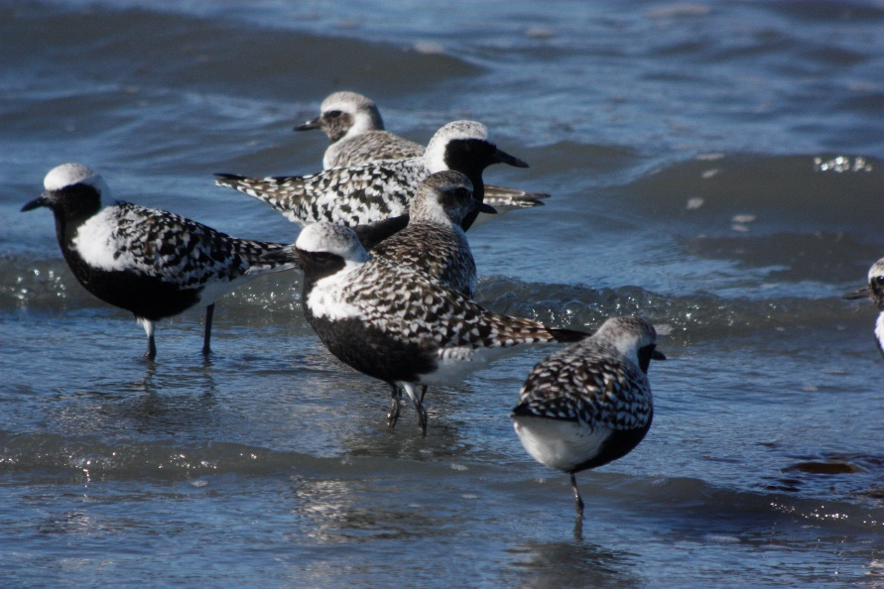
Mid-Spit Site

Slide 9
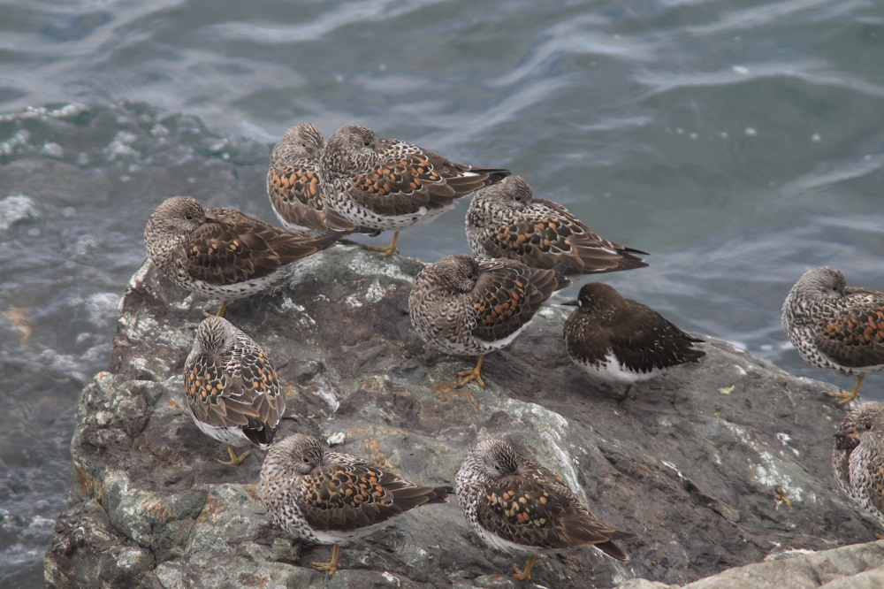
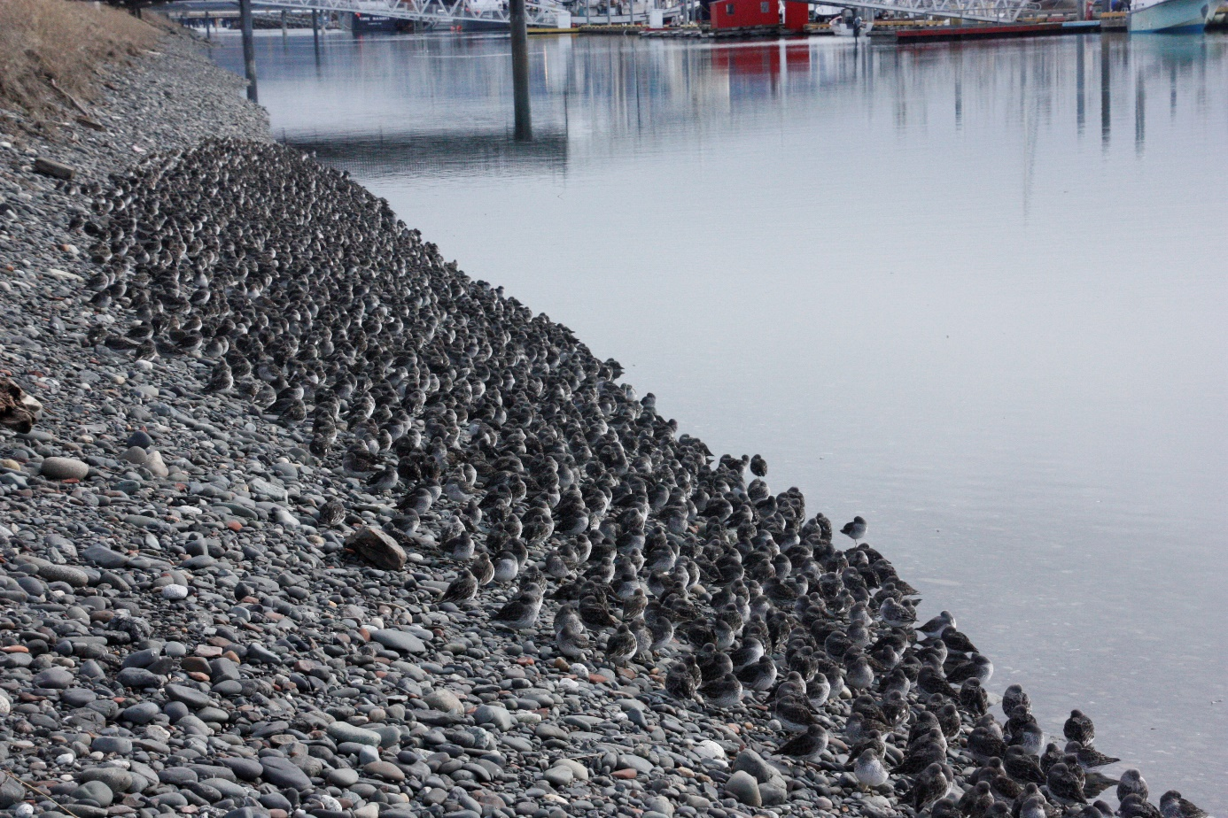
Boat Harbor Shorebirds
Surfbirds and Black Turnstone
Rock Sandpipers in Early Spring

Slide 10
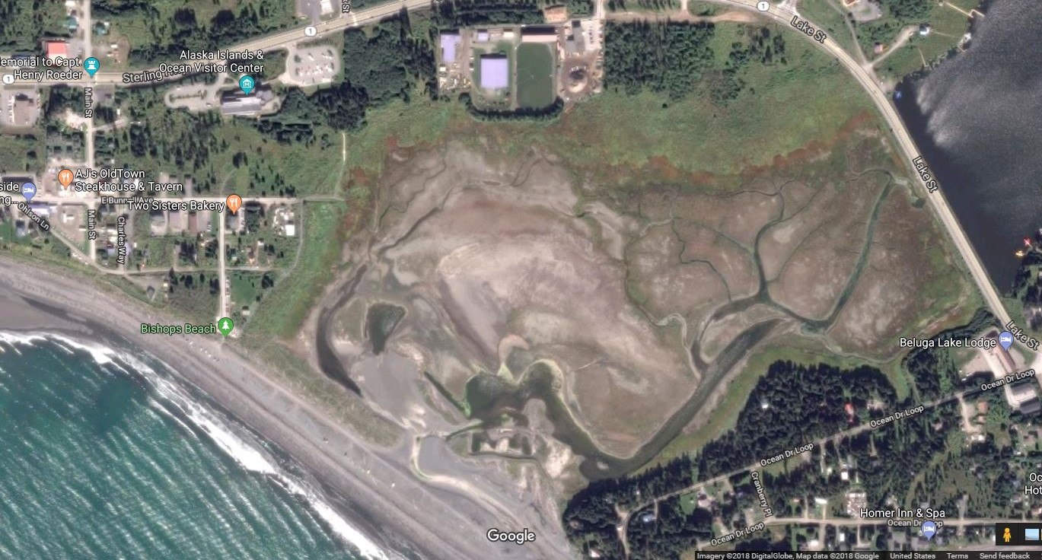
Beluga Slough Site

Slide 11
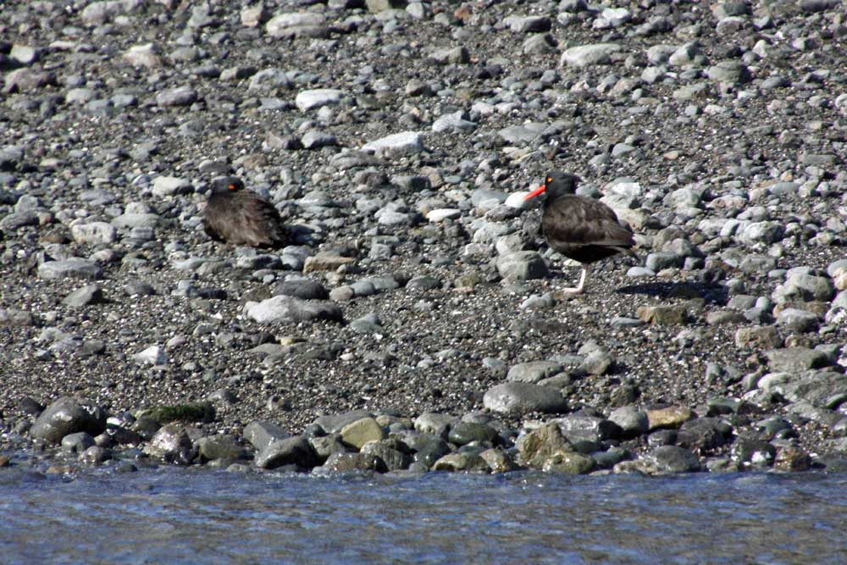
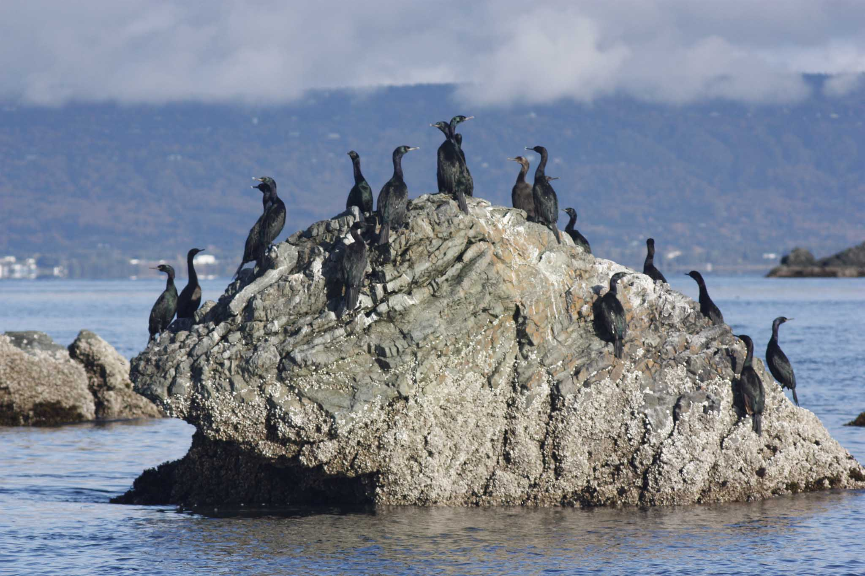
Islands and Islets
Pelagic Cormorants on Islet
Black Oystercatchers on Cohen Island

Slide 12
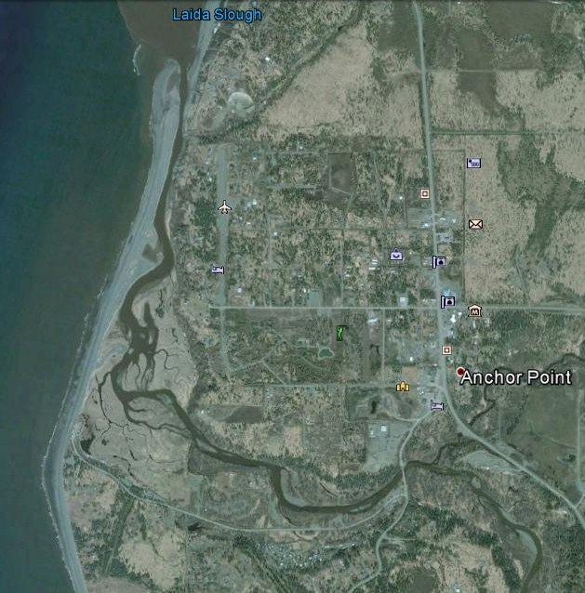
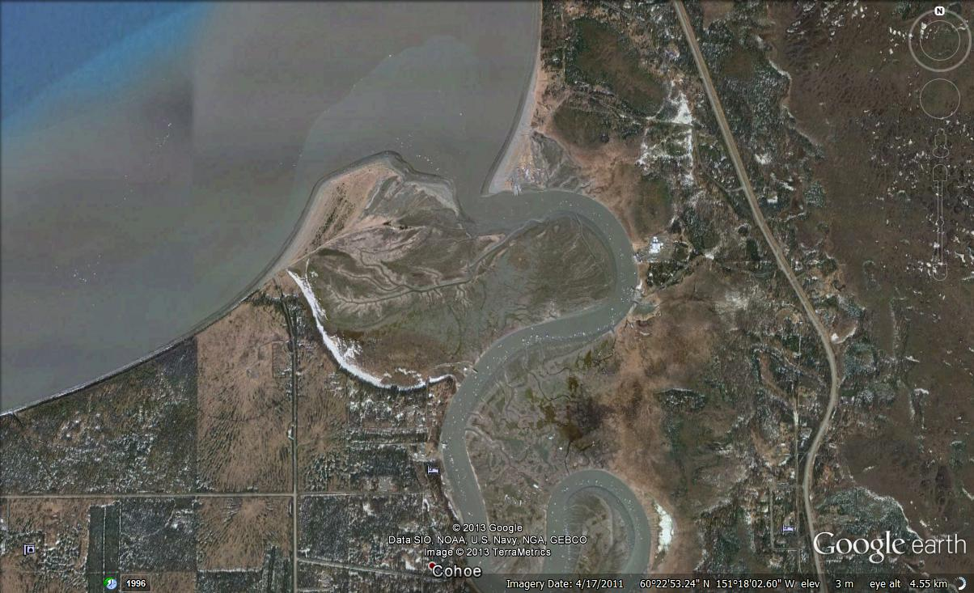
Shorebird Monitoring Sites Added in 2013
Anchor Point/River
Kasilof River

Slide 13
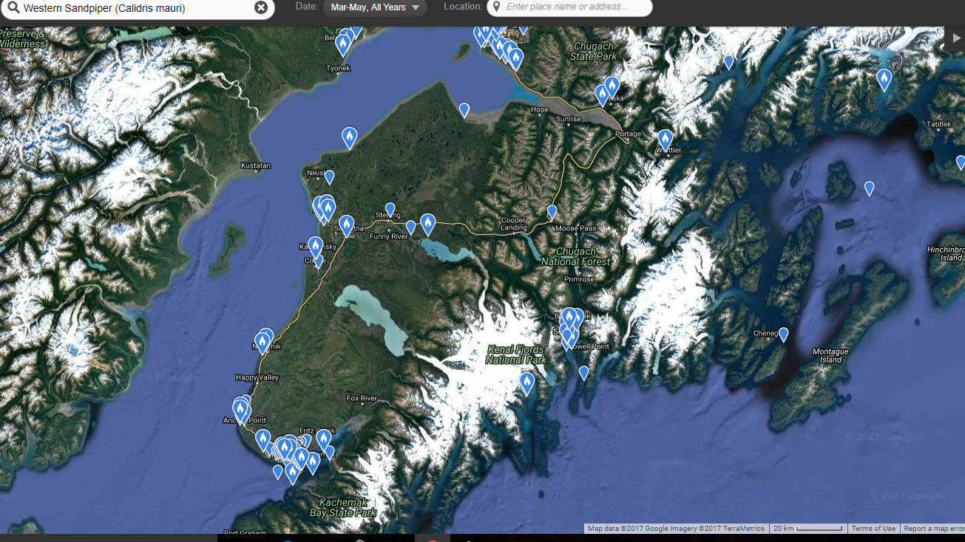
ebird Hotspots for Western Sandpipers

Slide 14
Kachemak Bay Shorebird Monitoring Project Protocol
Modified version of International Shorebird Survey (ISS) protocol.
1. ISS protocol states that monitoring frequency should be every 10 days.
Because stopovers in Alaska are much shorter, we monitor every 5 days
from mid-April to late May, bracketing the spring migration.
2. A team rather than an individual effort. Monitoring is done
simultaneously to;
  Provide more complete coverage.
  Minimize double-counting.

Slide 15
2022 Shorebird Monitoring Project Volunteers
Total of 75 volunteers

Slide 16
Kachemak Bay Shorebird Monitoring Project Protocol
Modified version of International Shorebird Survey (ISS) protocol.
1. ISS protocol states that monitoring frequency should be every 10 days. Because stopovers in Alaska are much shorter, we monitor every 5 days from mid-April to late May, bracketing the spring migration.
2. A team rather than an individual effort. Monitoring is done simultaneously to;
  Provide more complete coverage.
  Minimize duplication.
3. Monitoring times are based on;
  Optimal observation conditions.
  Consistency with tides.

Slide 17
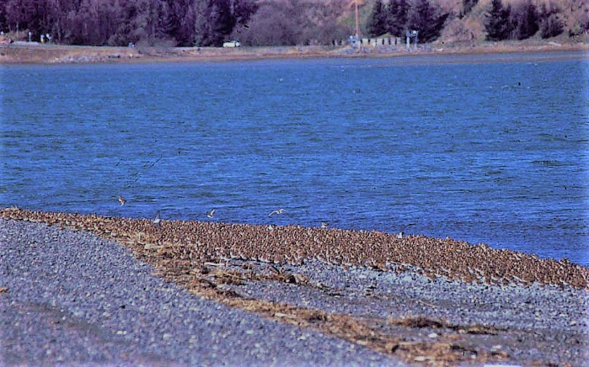
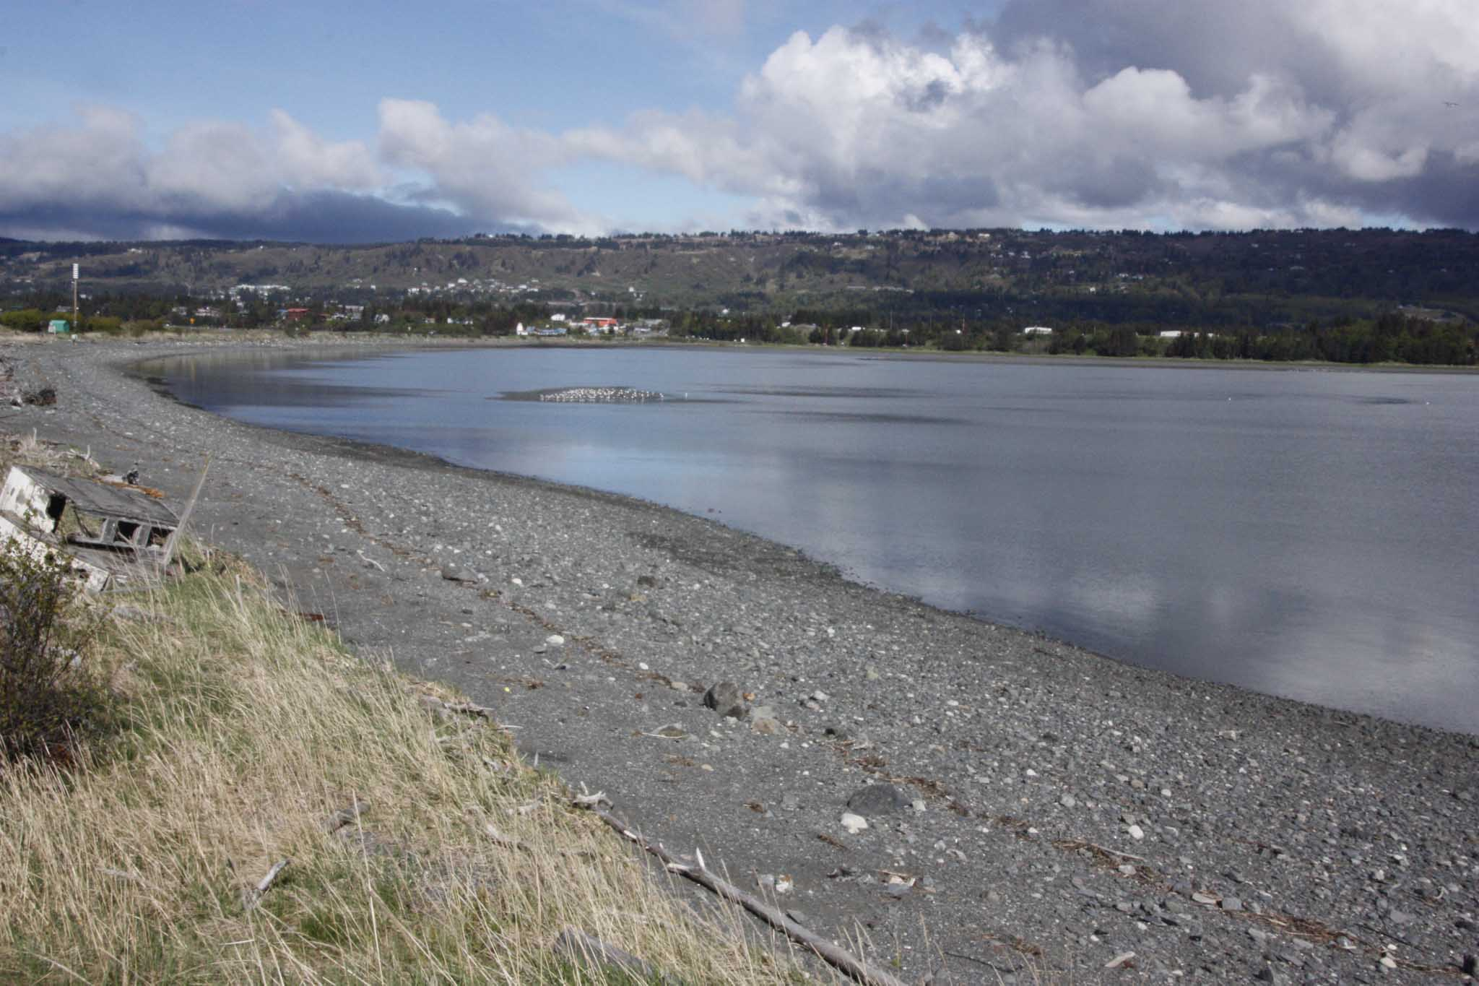
Optimal Monitoring Time
Tidal Range for April and May 2023 is from a low of -4.1’ to a high of 21.1’.
Mud Bay at a 15.0 Foot Tide
Western Sandpipers Roosting at High Tide

Slide 18
2023 Homer Spit and Anchor River
Monitoring Times and Tides

Slide 19
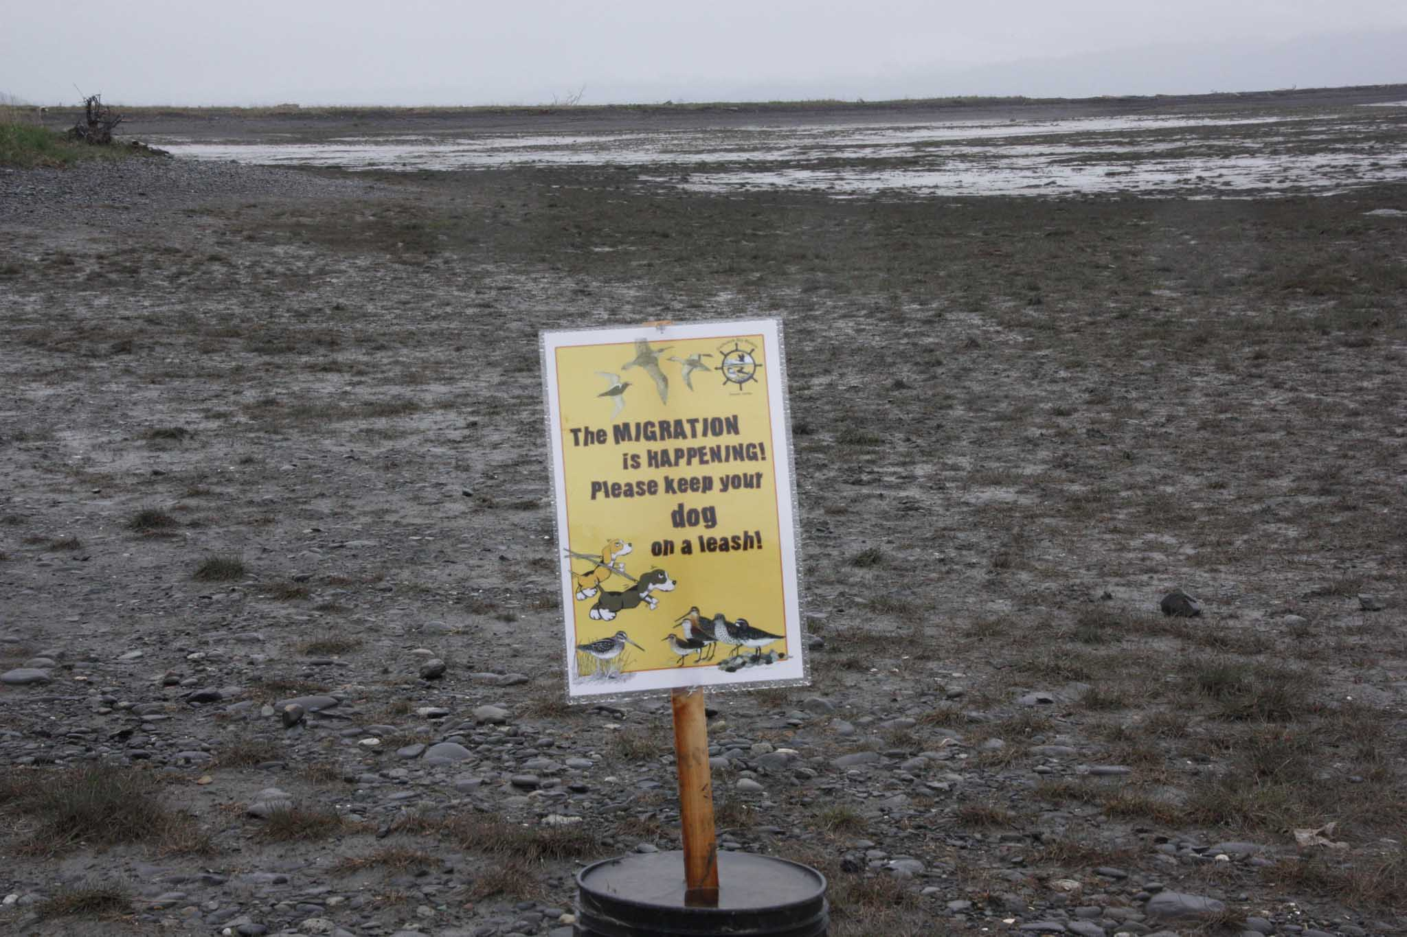
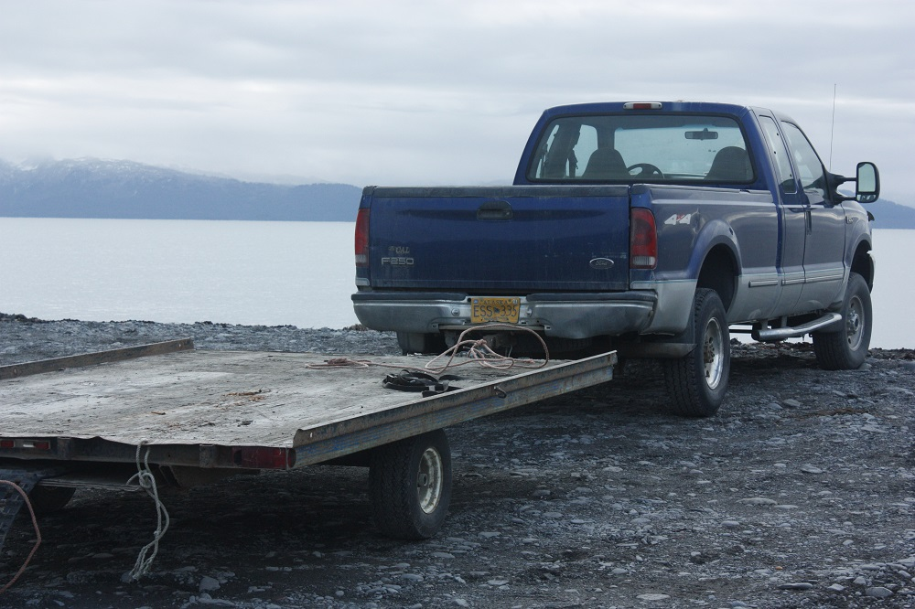
We Note Disturbances
Loose Dogs on Protected Beaches
Illegal Use of Off-Road Vehicles

Slide 20
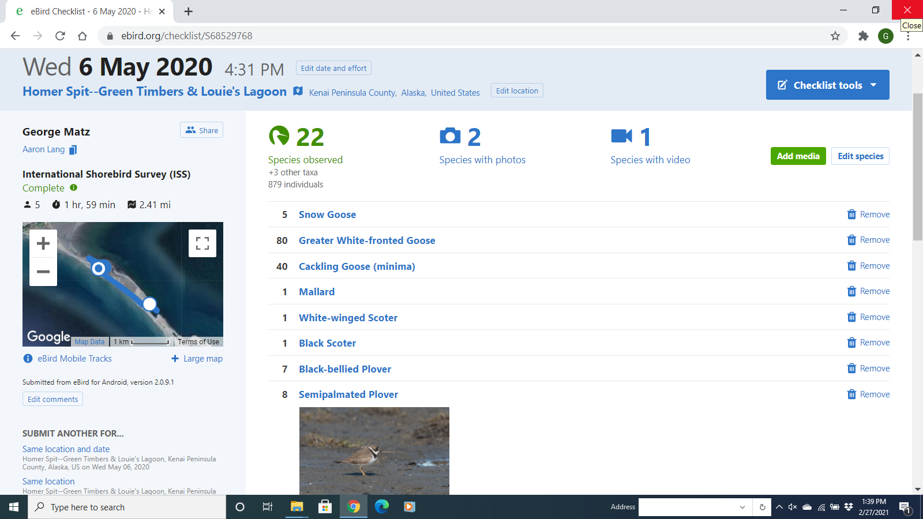
Observations reported via eBird

Slide 22
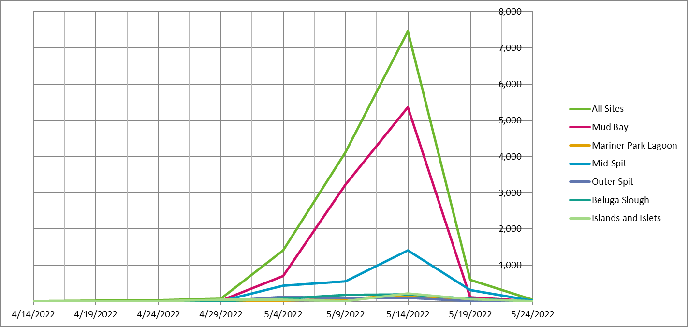

Slide 25
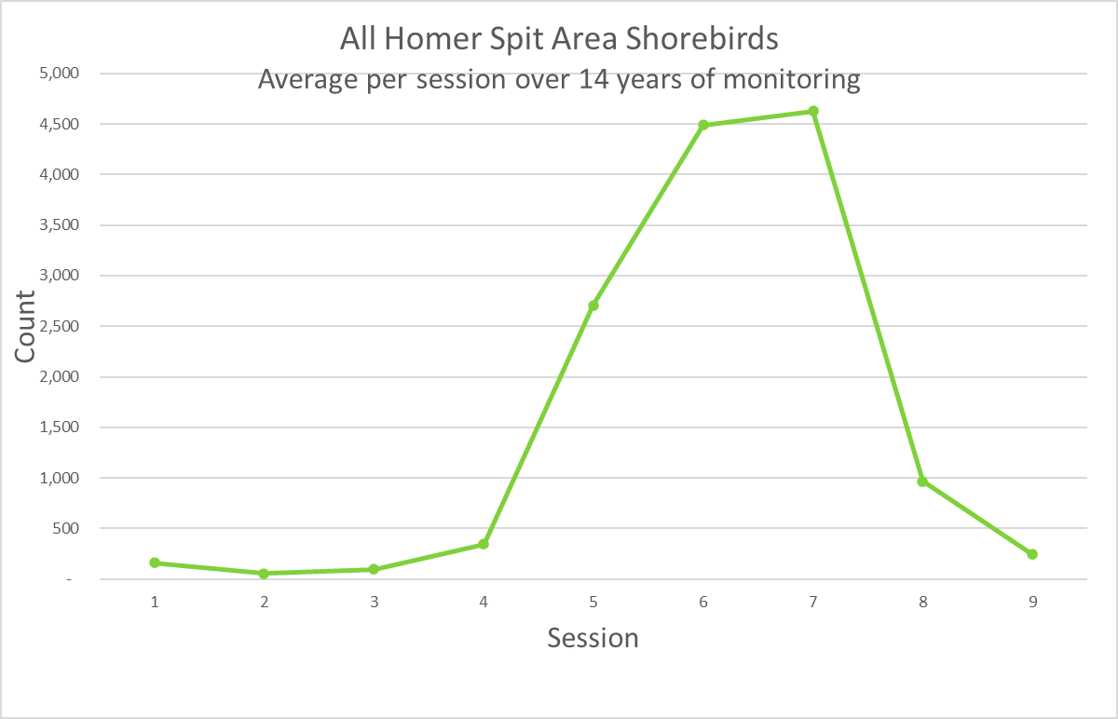

Slide 26
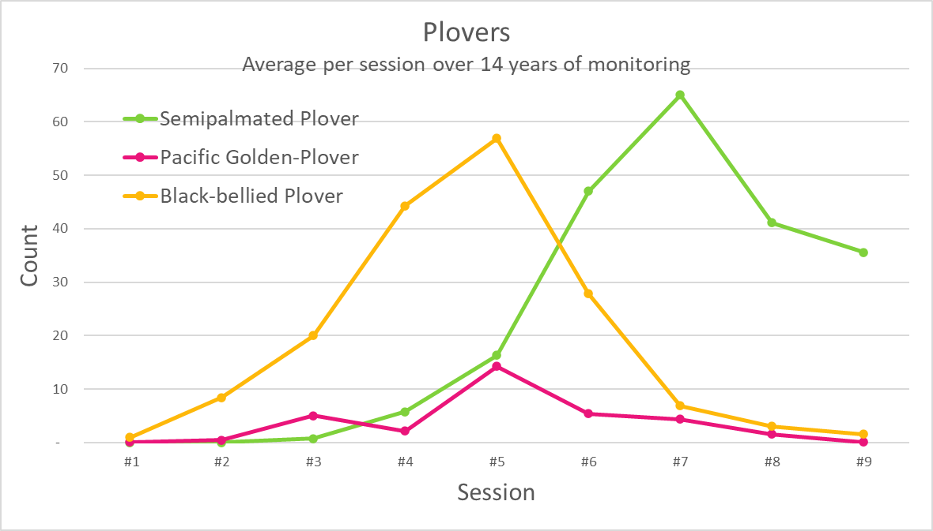

Slide 27
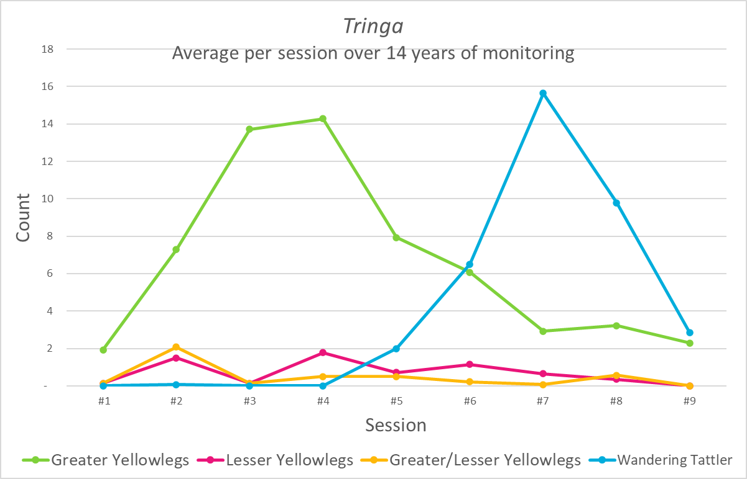

Slide 28
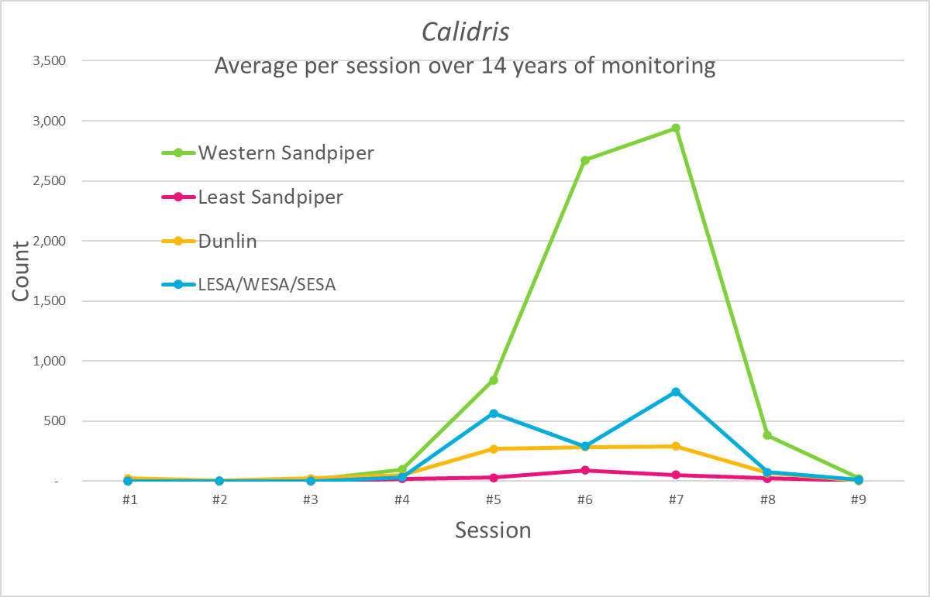

Slide 29
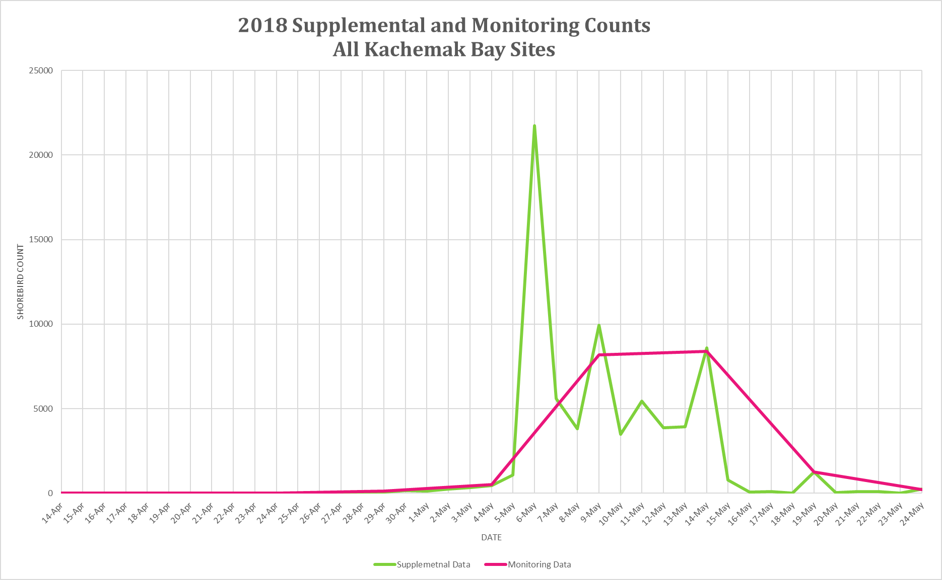

Slide 30
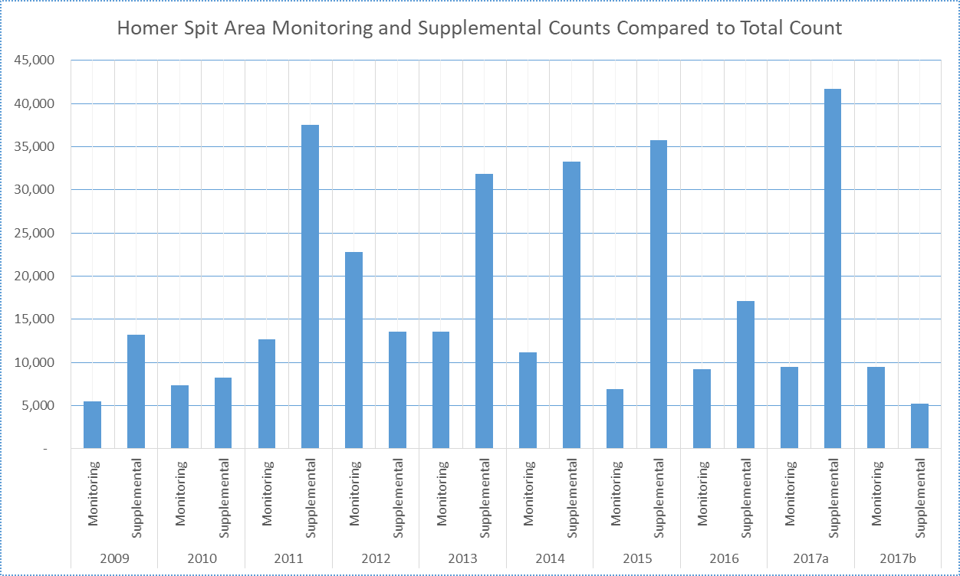
Comparing Monitoring Counts to Supplemental Counts
2009-2017
 | Count | % of Total
Monitoring | 107,993 | 0.31
Supplemental | 237,358 | 0.69
Total | 345,351 | 1.00

Slide 31
2022 Monitoring Results for the Anchor River

Slide 33
2022 Monitoring Results for the Kasilof River

Slide 35
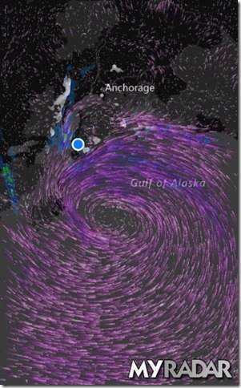
Stationary Low Pressure Over Gulf of Alaska in Early May 2017

Slide 36
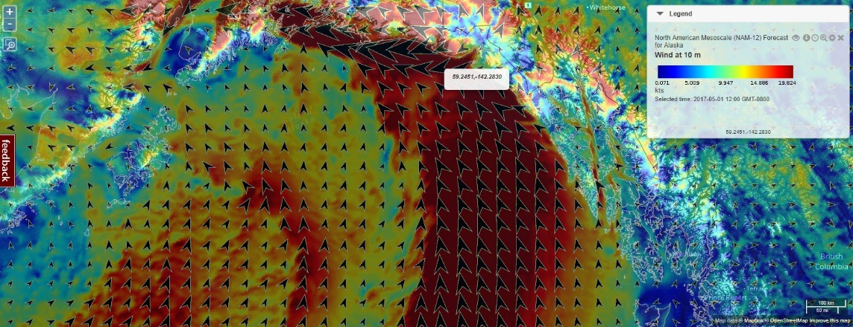
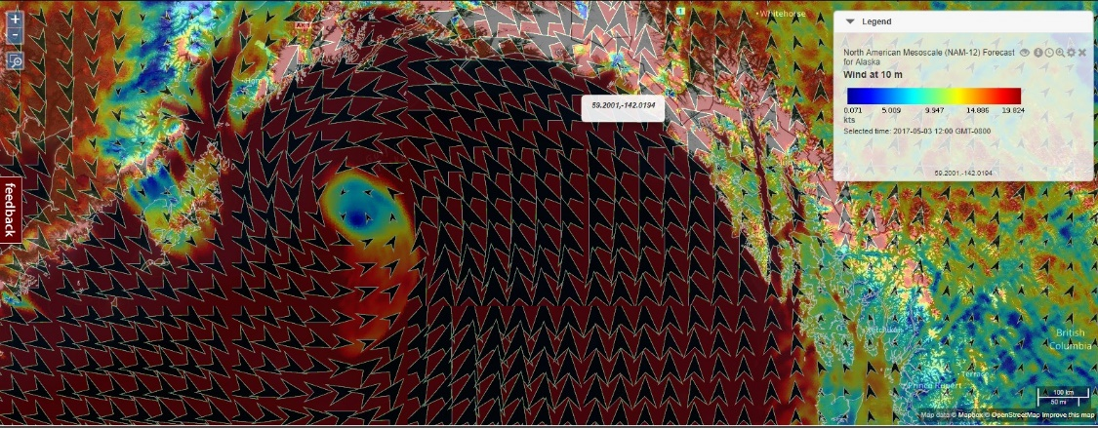
Wind Patterns before first WESA & DUNL peak on May 5.
May 1 - 21 DUNL and peeps
May 3 – 5,551 DUNL and peeps
http://portal.aoos.org/#map?lg=edc1ae33-1292-465b-8f52-28f2f3ffaa43

Slide 37
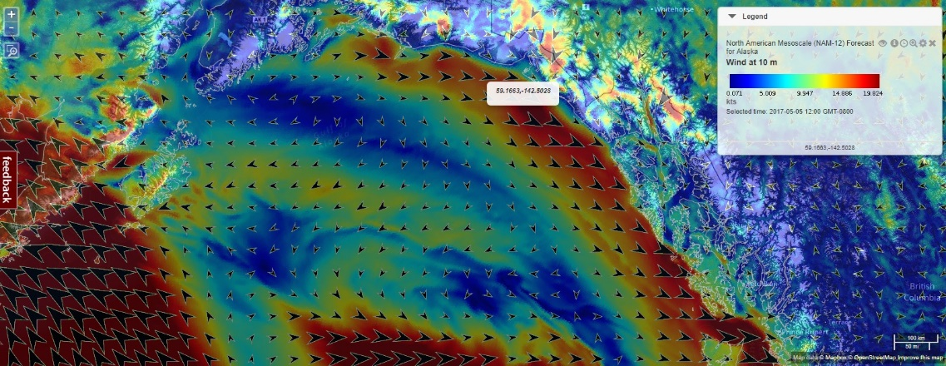
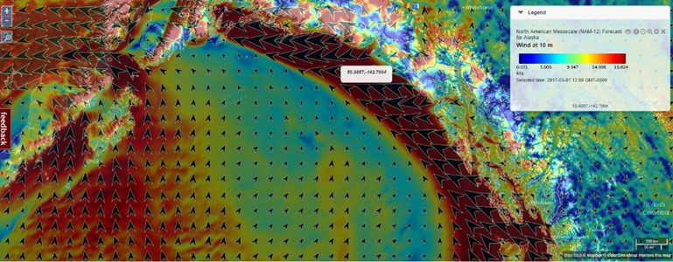
May 5 – 9,275 DUNL and peeps
May 7 – 3,401 DUNL and peeps

Slide 38
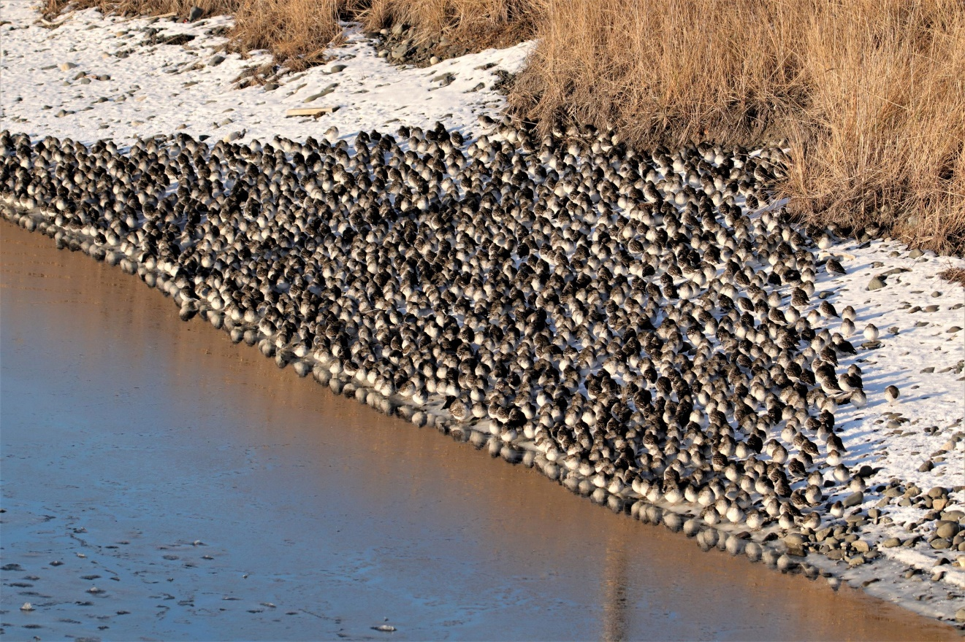
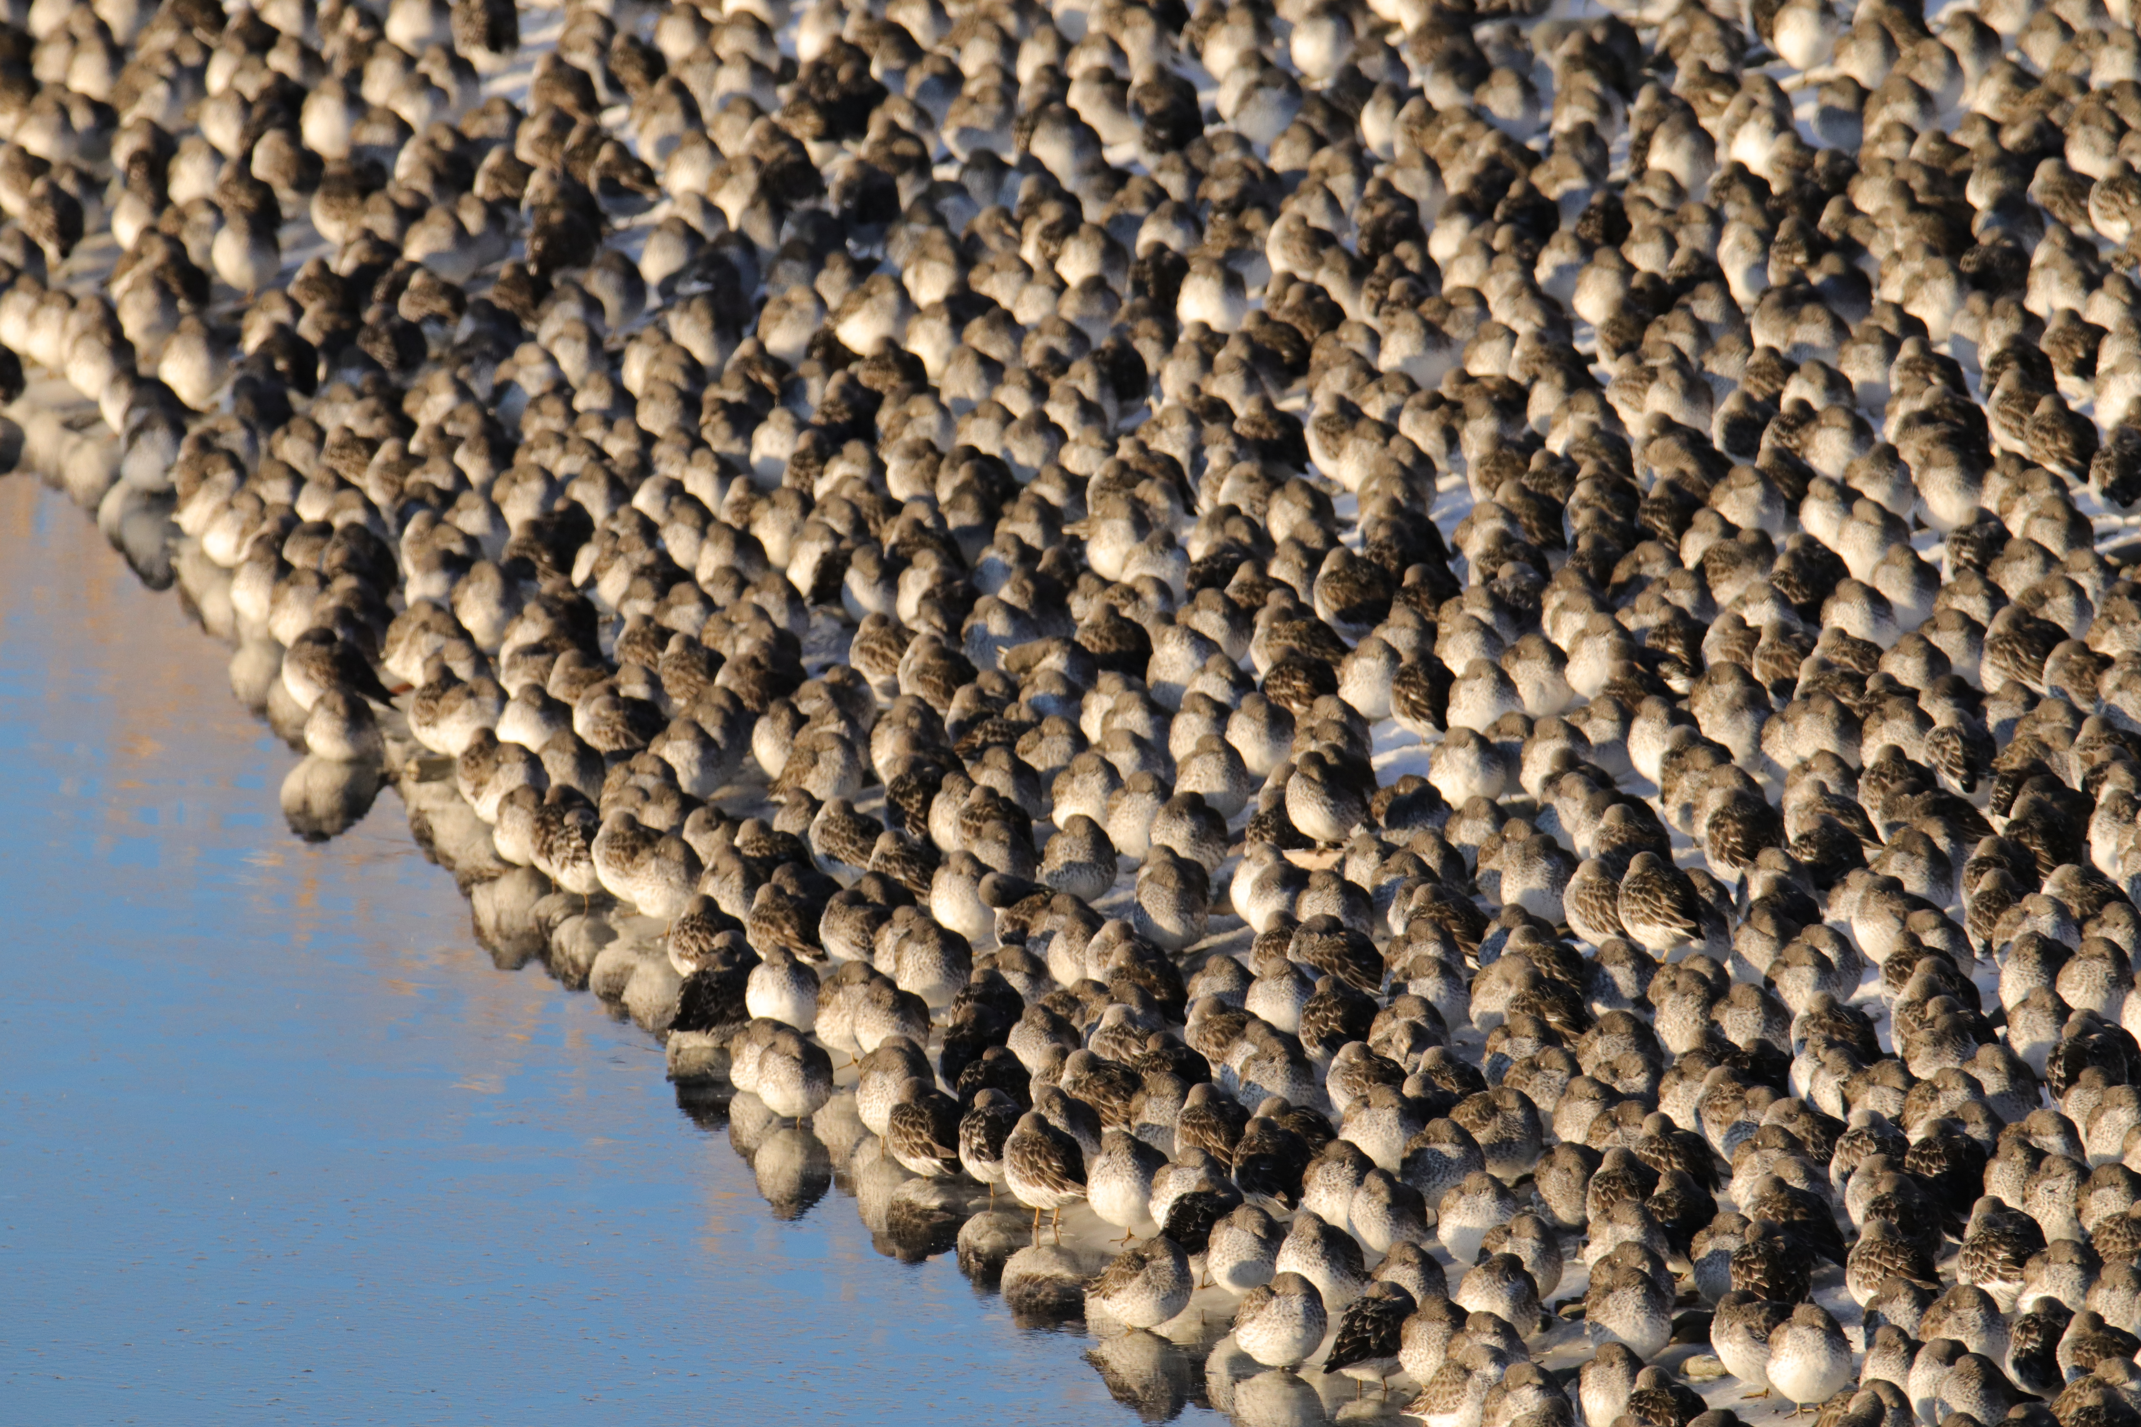
Overwintering Rock Sandpipers
Roosting at the Harbor

Slide 39
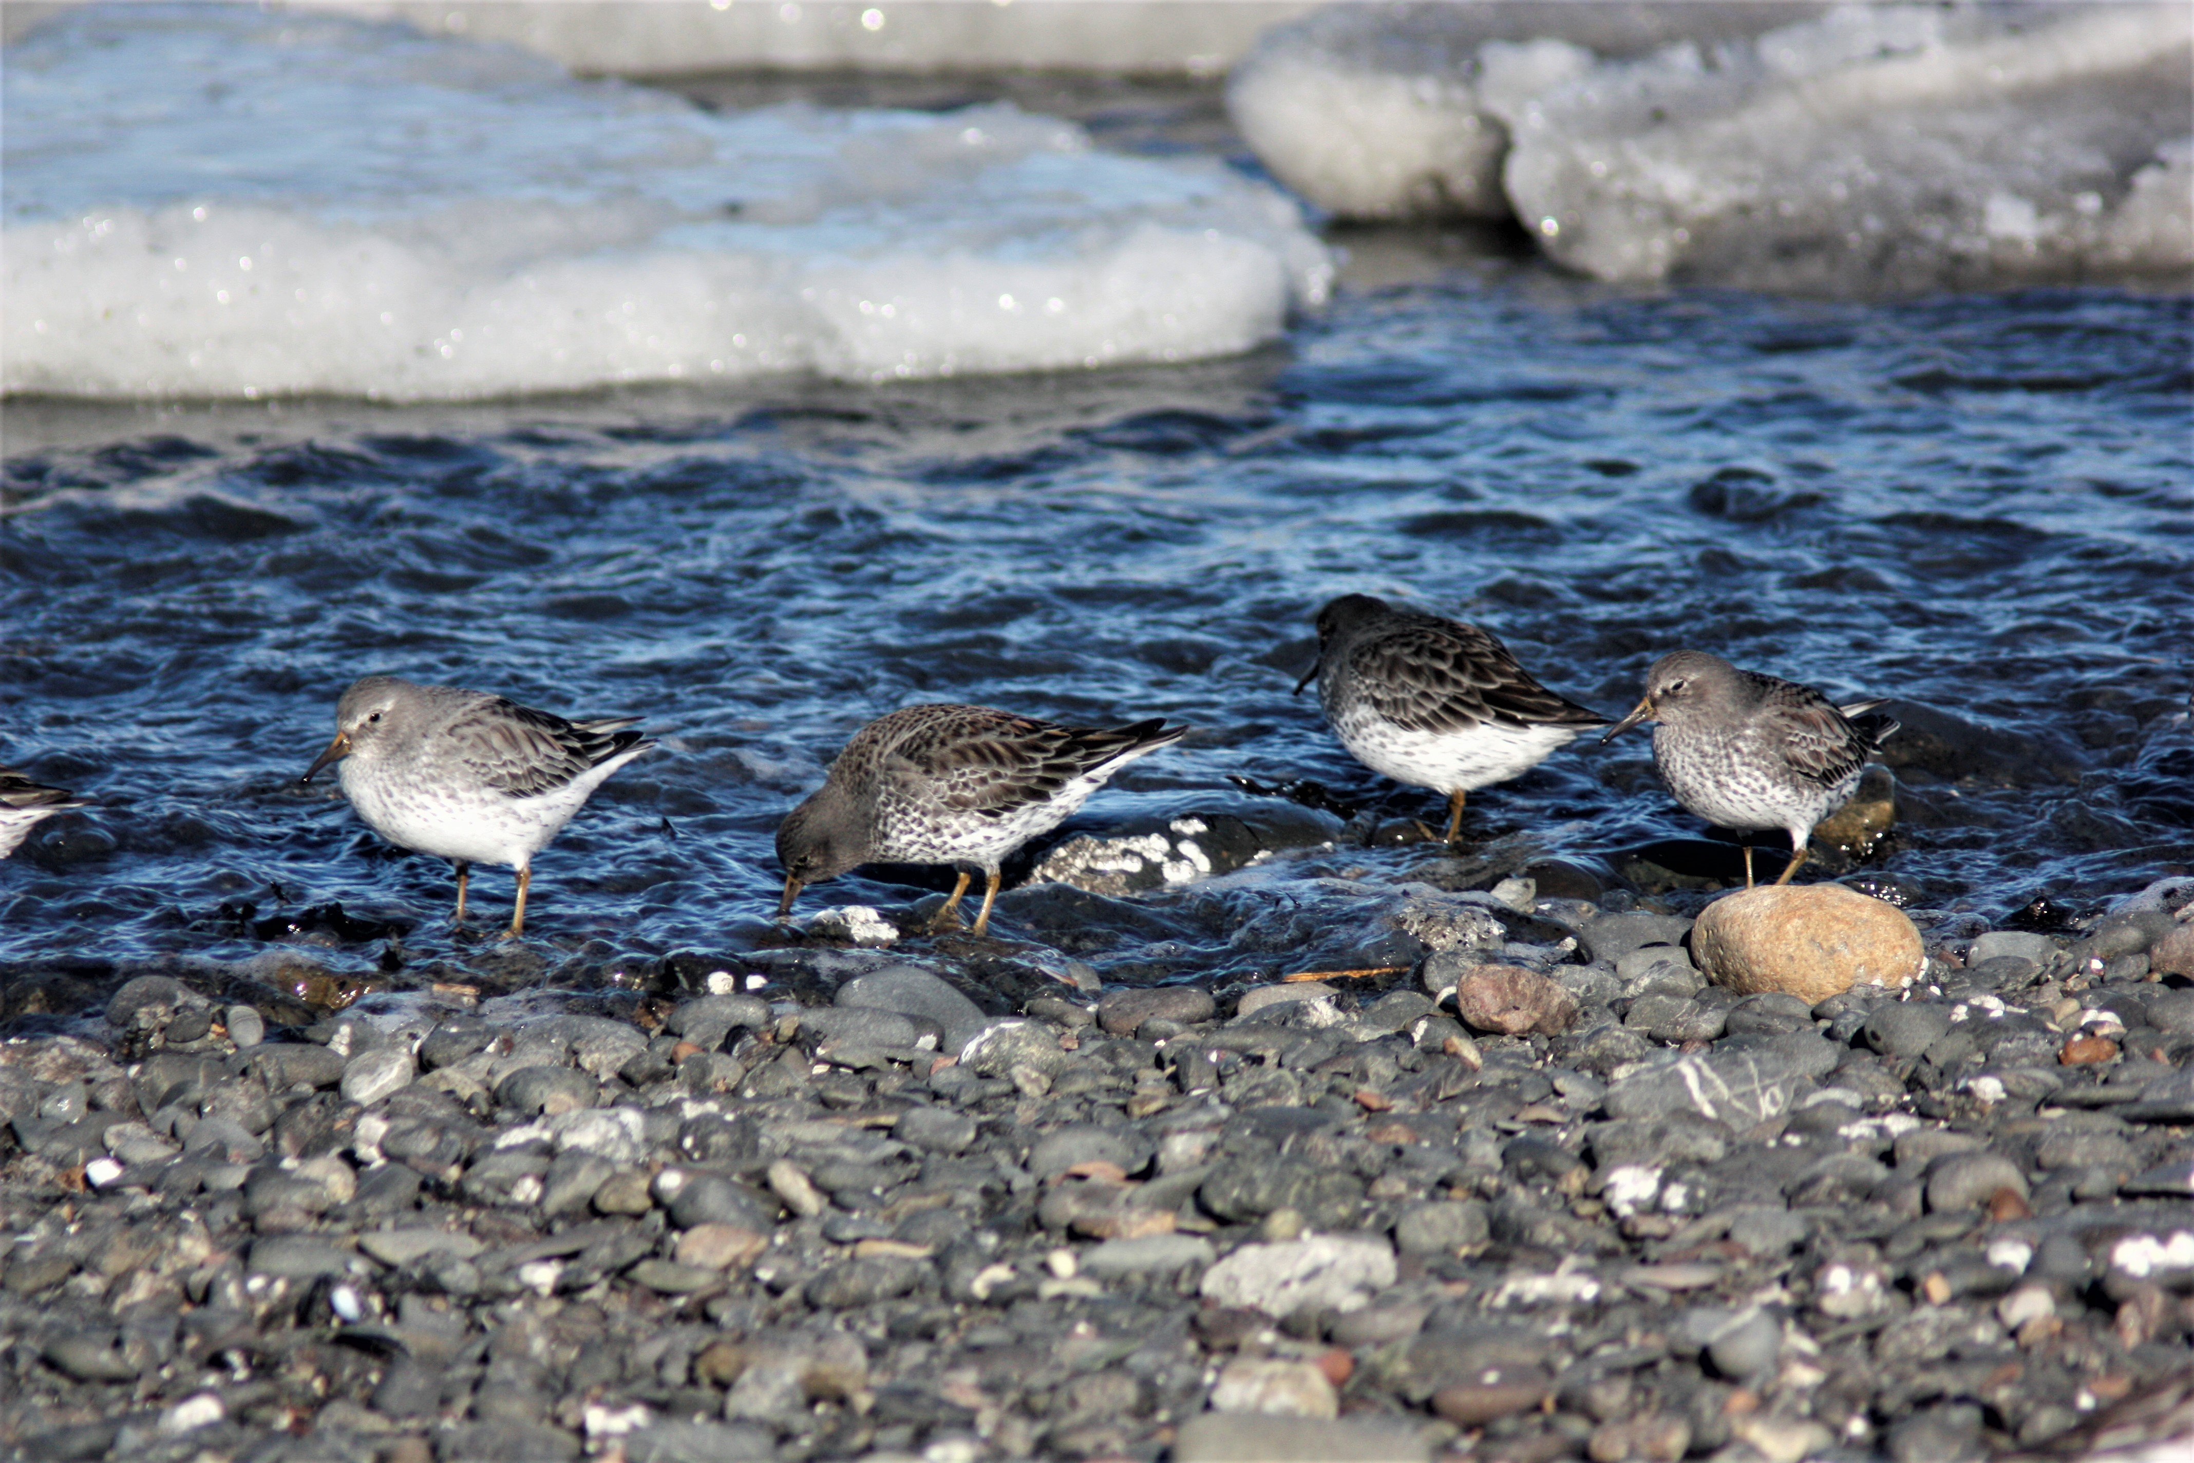
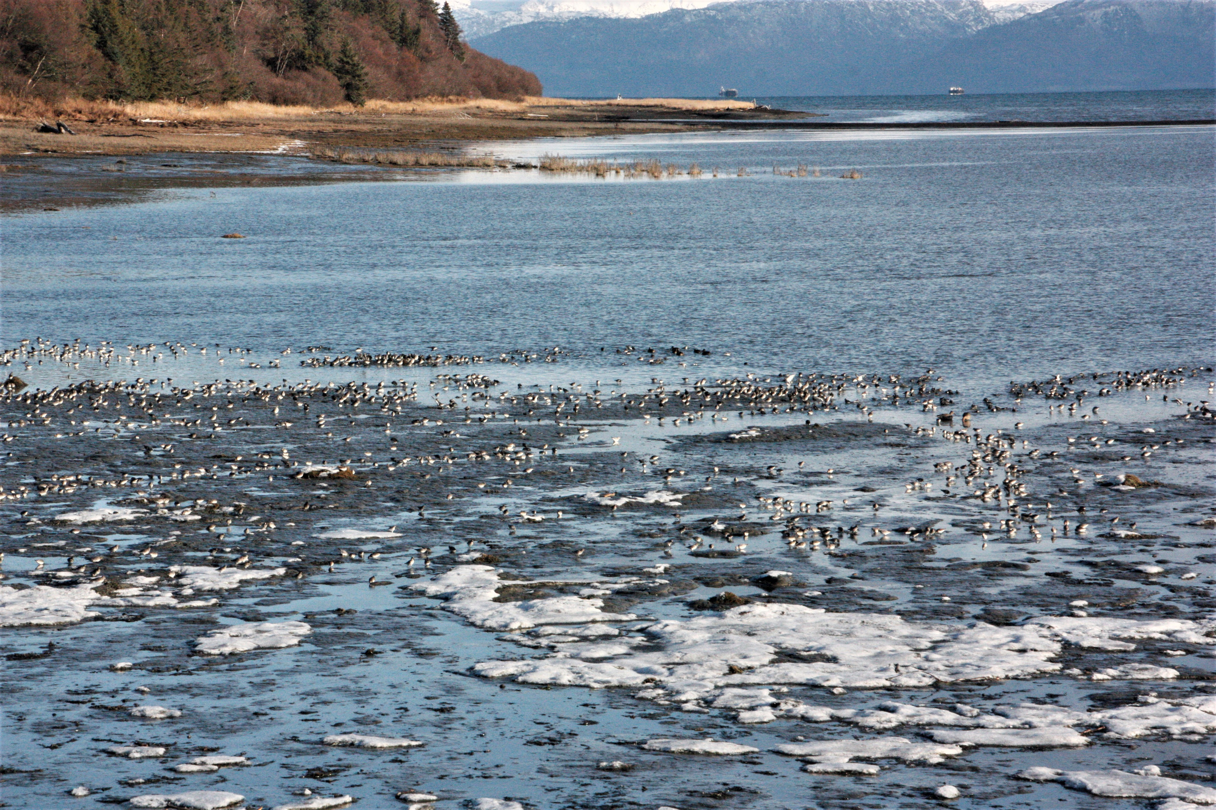
Overwintering Rock Sandpipers
Foraging in Mud Bay

Slide 41
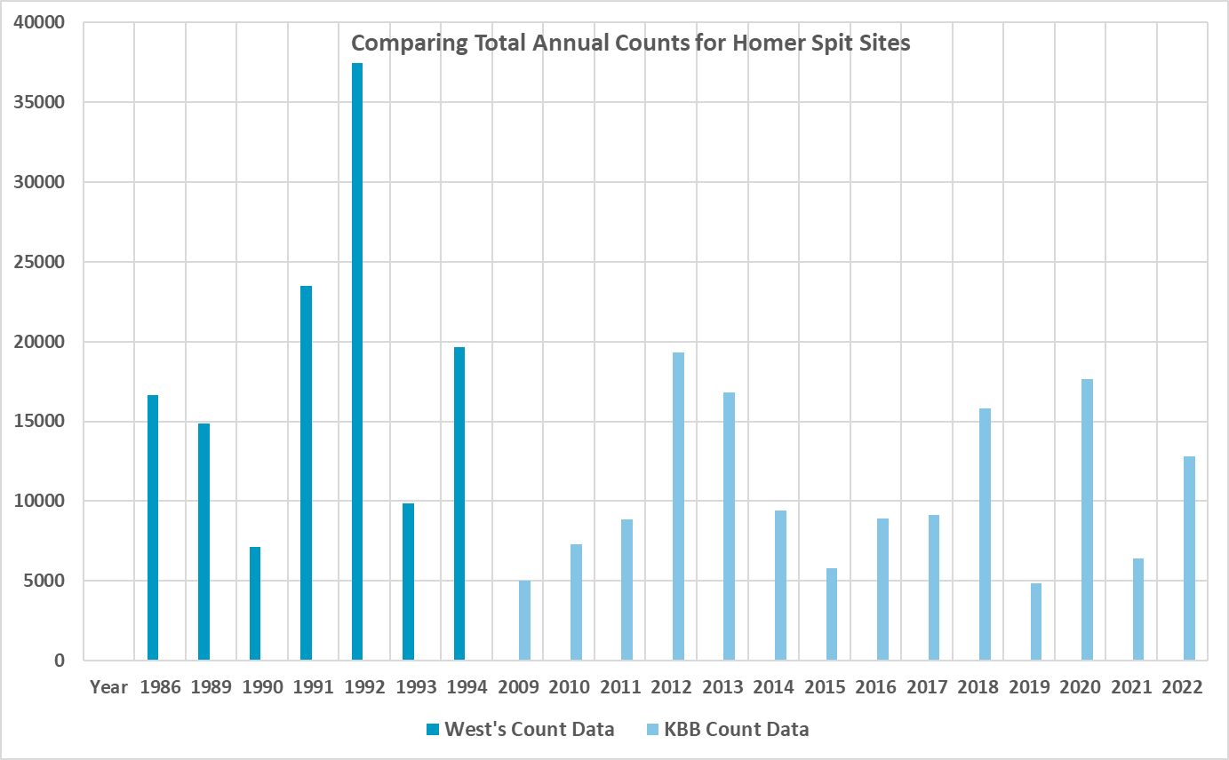

Slide 42
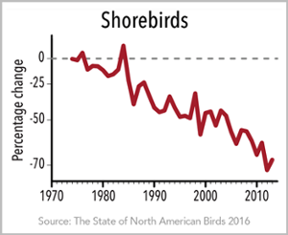
Migratory shorebird populations have declined by almost 70% since 1973.

Slide 43
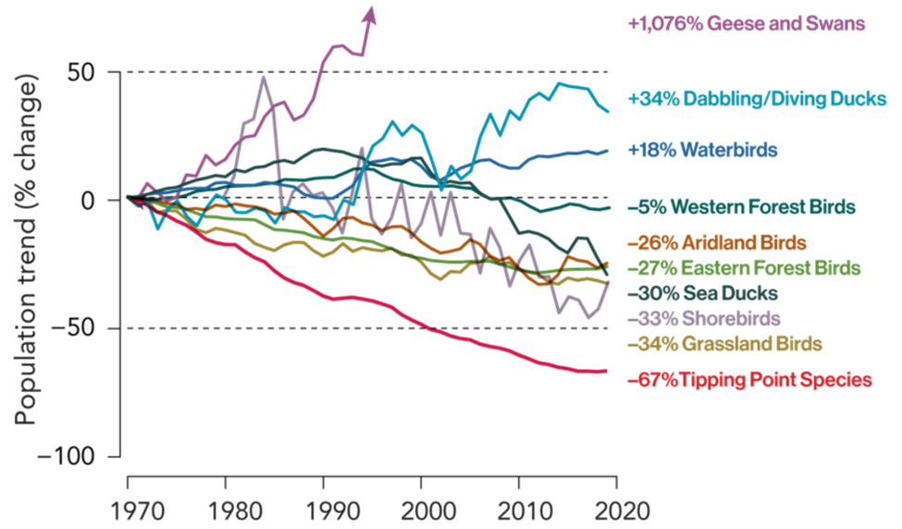
State of the Birds 2022
Trends for breeding bird species by group or by habitat during 1970–2019, except for the shorebirds trend, which begins in 1980.

Slide 44
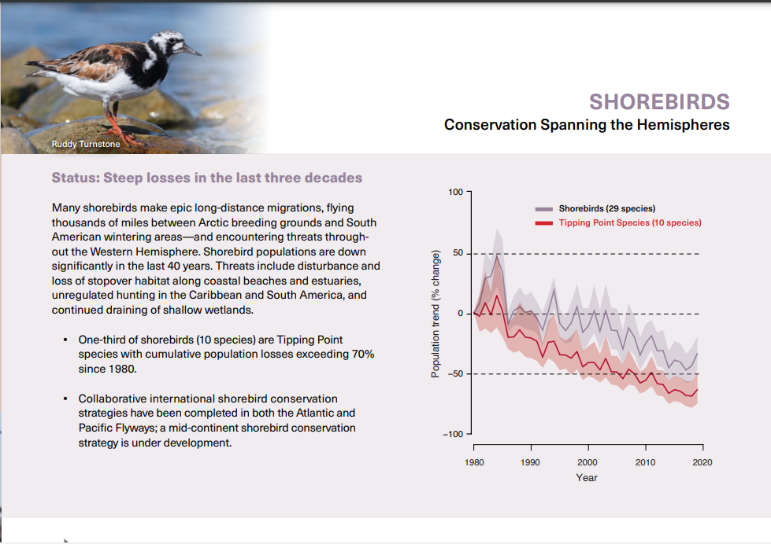

Slide 45
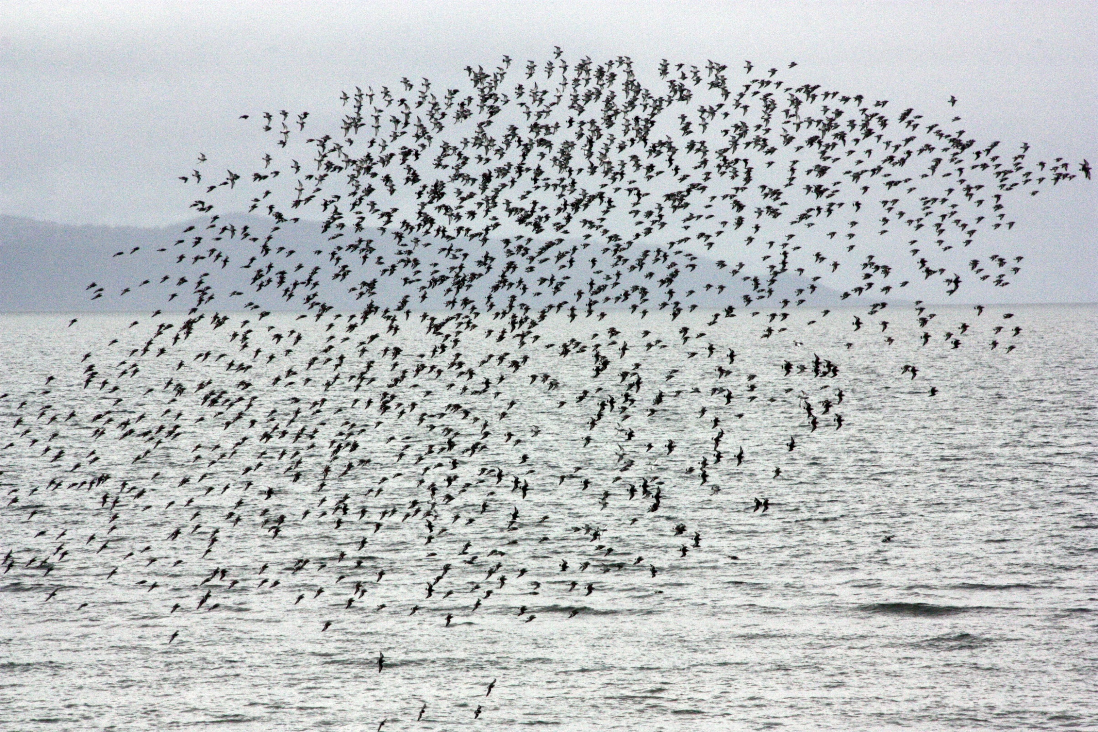
2,030 Surfbirds seen at Homer Spit on May 13, 2015.

Slide 46
Acknowledgements:
Brad A. Andres, Ph.D. who encouraged us to start this monitoring project.
National Coordinator, U.S. Shorebird Conservation Plan
U.S. Fish and Wildlife Service
Richard Lanctot, PhD who has provided needed support and advice.
Region 7 Shorebird Coordinator
U.S. Fish and Wildlife Service
All Kachemak Bay Birders volunteers over the past fourteen years.
The Kachemak Bay Shorebird Monitoring Project is based on volunteer effort and has no funding.

