Slide 1
COMMON BIRDS of KACHEMAK BAY

Slide 2
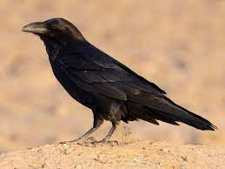
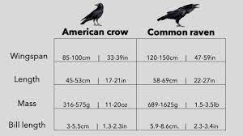
American Crow

Slide 3
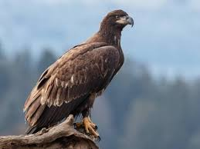
Bald Eagle

Slide 4
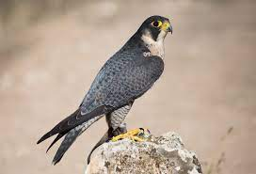
Peregrine Falcon

Slide 5
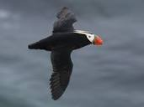
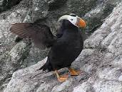
Tufted Puffin

Slide 6
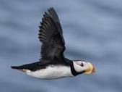
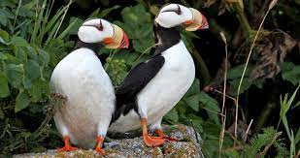
Horned Puffin

Slide 7
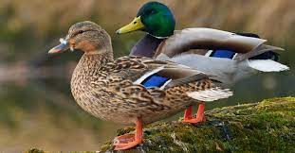
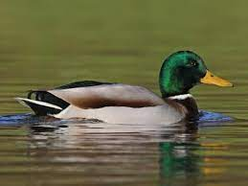
Mallard

Slide 8
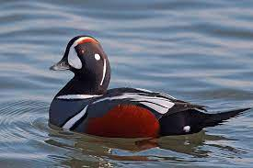
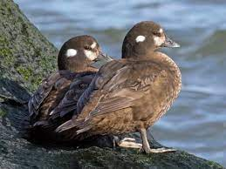
Harlequin Duck

Slide 9
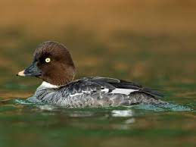
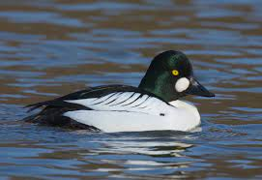
Common Goldeneye

Slide 10
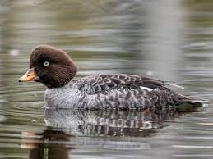
Barrow’s Goldeneye

Slide 11
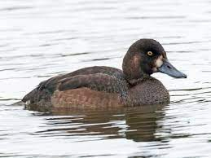
Greater Scaup

Slide 12
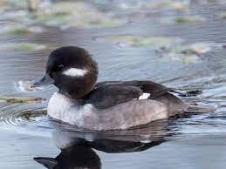
Bufflehead

Slide 13
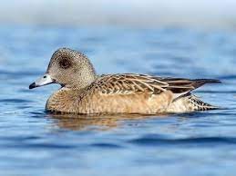
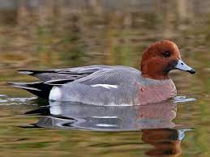
American Widgeon

Slide 14
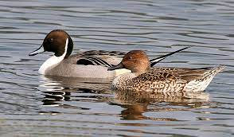
Northern Pintail

Slide 15
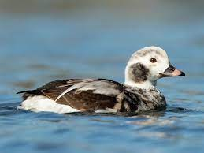
Long-tailed Duck

Slide 16
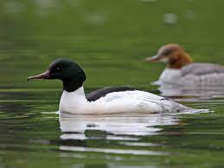
Common Merganser

Slide 17
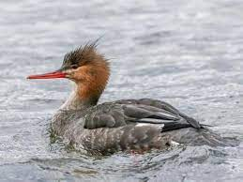
Red-breasted Merganser

Slide 18
Black Scoter

Slide 19
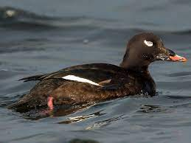
White-winged Scoter

Slide 20
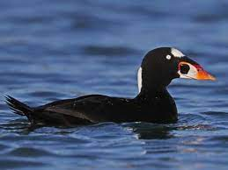
Surf Scoter

Slide 21
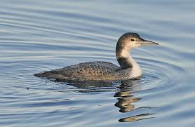
Common Loon

Slide 22
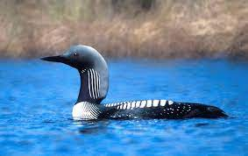
Pacific Loon

Slide 23
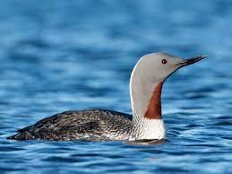
Red-throated Loon

Slide 24
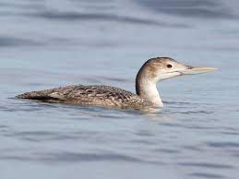
Yellow-billed Loon

Slide 25
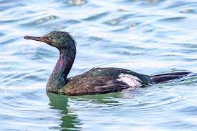
Pelagic Cormorant

Slide 26
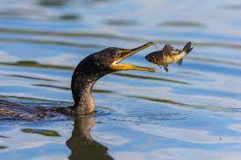
Double-crested Cormorant

Slide 27
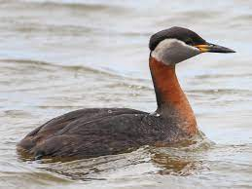
Red-necked Grebe

Slide 28
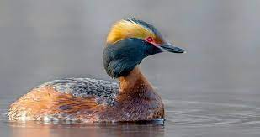
Horned Grebe

Slide 29
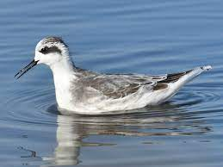
Red-necked Phalarope

Slide 30
Black Oystercatcher

Slide 31
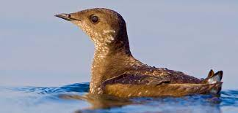
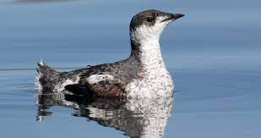
Marbled Murrelet

Slide 32
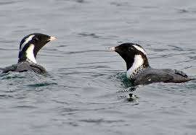
Ancient Murrelet

Slide 33
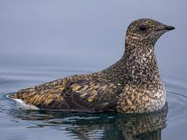
Kittlitz’s Murrelet

Slide 34
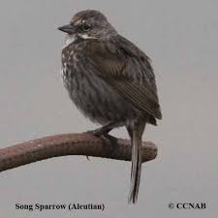
Song Sparrow

Slide 35
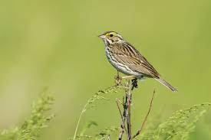
Savannah Sparrow

Slide 36
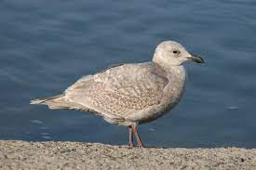
Glaucous-winged Gull

Slide 37
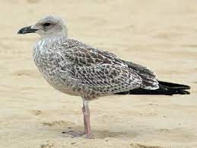
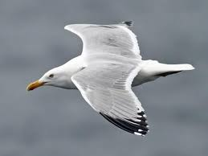
Herring Gull

Slide 38
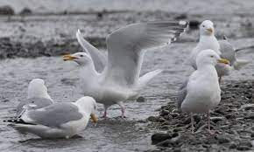
Cook Inlet Gull [hybrid]

Slide 39
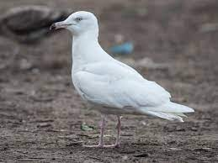
Glaucous Gull

Slide 40
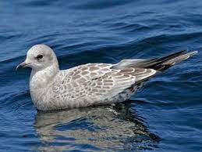
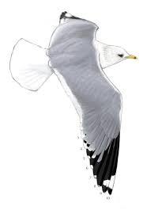
Short-billed Gull [Mew}

Slide 41
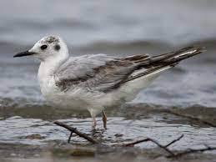
Bonaparte’s Gull

Slide 42
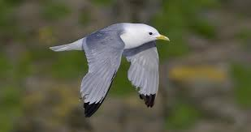
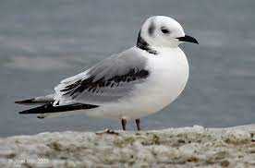
Black-legged Kittiwake

Slide 43
Belted Kingfisher

Slide 44
Surfbird

Slide 45
Black Turnstone

Slide 46
Ruddy Turnstone

Slide 47
Rock Sandpiper

Slide 48
Black-bellied Plover

Slide 49
Pacific Golden Plover

Slide 50
Dunlin

Slide 51
Sanderling

Slide 52
Western Sandpiper

Slide 53
Least Sandpiper

Slide 54
Semipalmated Sandpiper

Slide 55
Pectoral Sandpiper

Slide 56
Whimbrel

Slide 57
Dowitcher [Short/Long-billed]

Slide 58
Eiders

Slide 59
QUESTIONS AND COMMENTS?

